Slide 1


Maths workshop
EYFS
Notes:
Welcome everyone, and thank you for coming. Today is about giving you a simple picture of how we develop early mathematical understanding in EYFS and, most importantly, how you can support this at home.
We want maths to feel enjoyable, practical and part of everyday life. You do not need to sit down and teach formal maths lessons at home — everyday conversations, routines and play provide wonderful opportunities.

Slide 2
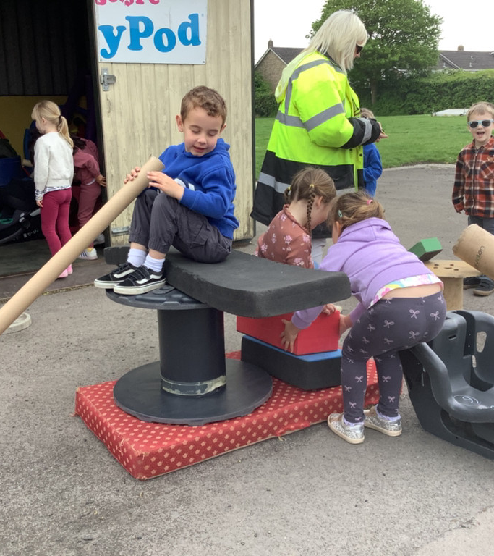
“Children are born ready, able and eager to learn. They actively reach out to interact with other people, and in the world around them. Development is not an automatic process, however. It depends on each unique child having opportunities to interact in positive relationships and enabling environments.”
Notes:
This workshop is an introduction to the maths approach we use in EYFS.
We will look at what we mean by mastery, why we use practical resources and representations, and some of the key ideas your children are developing, including subitising, counting, composition of number and the use of five and ten frames.
The main message is that confident mathematical thinkers are built through lots of meaningful experiences and talk.

Slide 3

At St John & St Francis Church School, we believe that everyone can do Maths. We aim to develop a culture of deep understanding, confidence and competence in mathematics that produces strong, secure learning and real progress. Our goal is to ensure that when pupils leave us, they are assured, happy and resilient mathematicians who relish the challenge of maths. They will be independent and reflective thinkers, whose skills not only liberate them in maths but also support them across the curriculum.
Notes:
This quote captures an important principle for early years: children are naturally curious and motivated to learn, but they need positive relationships and enabling environments to help that learning happen.
In maths, this means giving children time to explore, notice, predict, explain and try things out. Our role is to provide the experiences and language that help children make sense of the mathematical ideas they encounter.

Slide 4

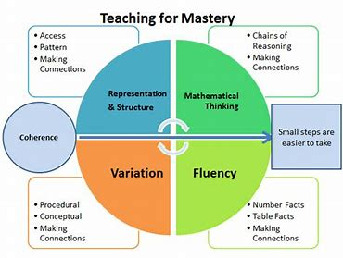
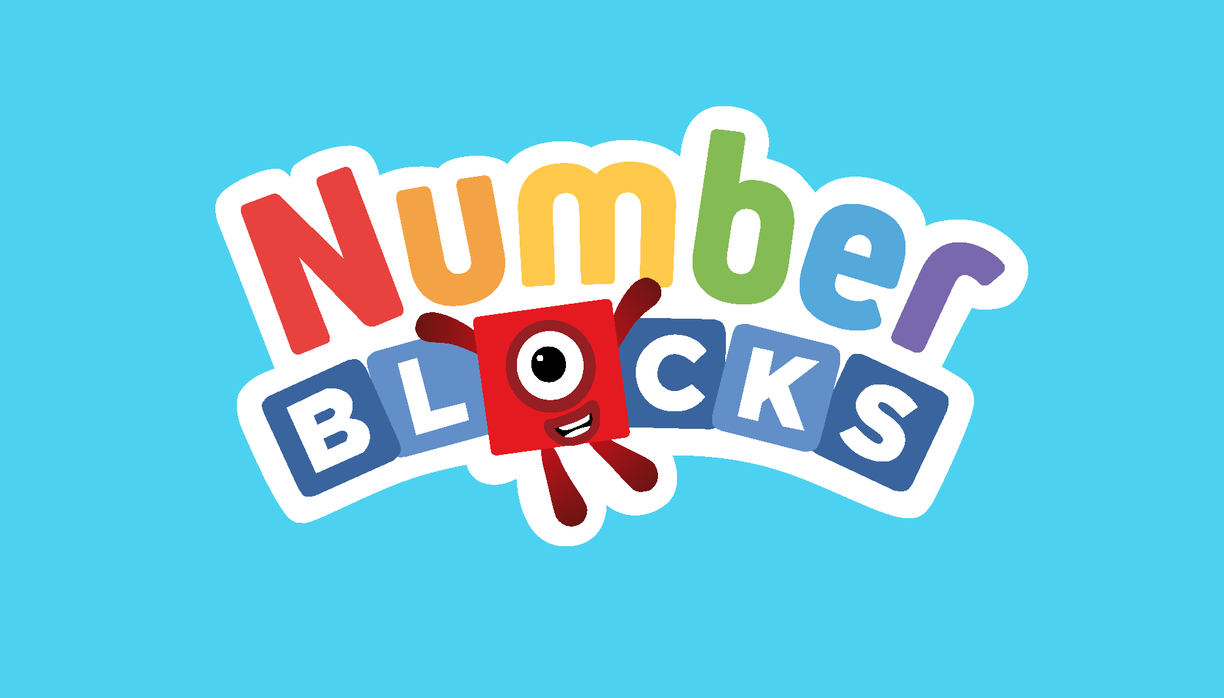
What is Mastery?
“In mathematics, you know you’ve mastered something when you can apply it to a totally new problem in an unfamiliar situation.”
Notes:
Our school belief is that everyone can do maths. We want children to develop deep understanding rather than simply memorising procedures.
For young children, confidence and resilience are particularly important. We want them to have a go, make mistakes, explain their thinking and understand that there can be different ways to solve a problem.
This is also why we make maths meaningful and connect it to children's wider learning and everyday experiences.
The diagram on this slide shows what we mean by teaching for mastery and what is known as ‘The five big ideas’. It can look quite complicated, but the simple idea is that we want children to develop a really secure understanding of a mathematical idea before moving on.
We don't want children simply to memorise a number fact or learn a method because they have seen it before. Instead, we give them lots of opportunities to explore the same idea in different ways — using real objects, pictures, their fingers, practical resources and mathematical language.
Some children need more time and practice with an idea, while others are ready to make connections and use it in a new way. That's absolutely fine. Mastery doesn't mean that every child does the exact same thing at exactly the same time. It means that we make sure children have the scaffolding in place to enable them to make connections and develop the understanding they need before building on it.
For example, when learning about the number 5, we don't just want a child to recognise the numeral '5'. We want them to understand that five means a quantity, recognise five in different arrangements, know that five can be made in different ways, and be able to talk about what they notice.
So, when you see your child playing with counters, using their fingers, looking at a five-frame or talking about how many objects there are, these are all important parts of developing that deeper mathematical understanding.

Slide 5
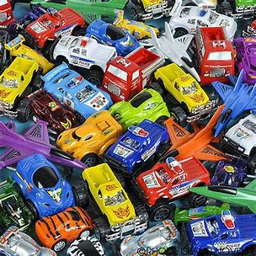
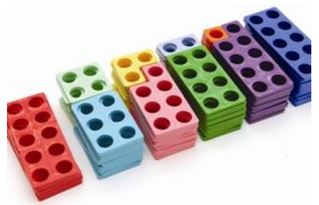
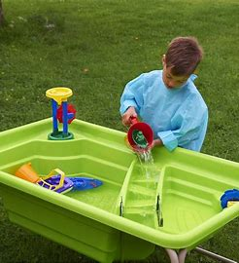
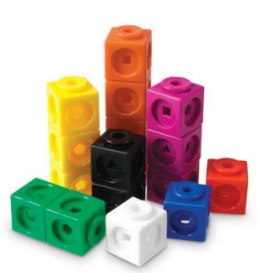
The Concrete, Pictorial, Abstract approach (CPA)
Notes:
This slide shows the Concrete, Pictorial and Abstract approach, often called CPA.
It sounds quite technical, but the idea is actually very simple: children need to experience maths before they can fully understand and use the symbols that represent it.
Concrete means children are able to physically do the maths. They might use counters, cubes, Numicon, their fingers, objects from the environment or even toys. For example, if we are exploring the number 5, children might physically collect five objects and move them around to see what happens.
Pictorial means we then help children represent what they have experienced. They might use dots, drawings, a five-frame or another visual representation. This helps them begin to hold the mathematical idea in their heads rather than always needing the physical objects.
Abstract is when children begin to use the mathematical symbols and language we associate with maths — for example, recognising the numeral 5 or eventually recording a calculation.
It's important to say that these aren't three separate stages that every child moves through in a straight line. Children will move between them depending on what they are learning and how secure their understanding is. Even when children appear to be working at the 'abstract' level, we can go back to concrete resources or pictures if that helps them understand something more deeply.
We are looking for understanding, flexibility and the ability to make connections.
The importance of language
We use stem sentences to help children understand the maths, organise their thinking and share their ideas, reducing cognitive load.
We also use gestures alongside language to support understanding. Children use these gestures to make connections between different mathematical concepts and link their mathematical learning to wider areas of the curriculum.

Slide 6
Progression in Maths: St John and St Francis - Home
Notes:
This link will take you to our school website. If you click ‘curriculum’ and then ‘maths’, you will be able to find our Maths progression documents so that you can see what the focus of your child’s learning will be over the course of the year. Mathematical development is cumulative. Children need secure foundations before they can confidently build the next idea. You will see that we revisit important concepts regularly, giving children opportunities to practise them in different contexts and make connections.
There are other supporting materials that you might find useful during your time with us at St John and St Francis.

Slide 7

Subitising – The super power you never knew you had!
Dots, fingers and 5 frames (subitising) - Speaking cards (wordwall.net)
Notes:
Subitising is the super power that you never knew you had. Early subitising begins from birth. Babies are naturally drawn to faces and can notice and recognise features such as two eyes, two ears and one nose. Through looking closely at faces, babies begin to develop an awareness of small quantities and patterns.
We continue to develop this skill through dots, fingers, objects and familiar patterns, helping children to build a strong sense of number and recognise quantities quickly. “Say the amount, do not count!”
Subitising is an important foundation for developing fluency in later mathematics, as it helps children recognise numbers, see relationships between quantities and make connections without always relying on counting.

Slide 8
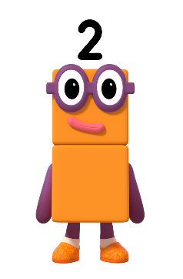
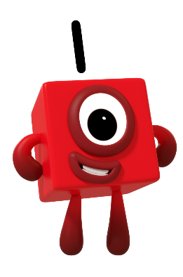
Can you say our numbers?
Images © 2021 Alphablocks Ltd. All rights reserved. Mastering Number 2021/22 ncetm.org.uk
Notes:
Mastering Number and Numberblocks
We use Mastering Number to develop children’s understanding of number through short, regular and playful activities. Numberblocks, developed with mathematics educator Debbie Morgan and other leading maths educators and experts, supports this approach by bringing numbers to life.
Children learn to see, hear and talk about number relationships, helping them understand how numbers are made up of smaller parts and connect to one another.
Together, these experiences build a secure sense of number, providing a strong foundation for later mathematical fluency, reasoning and problem-solving.

Slide 9
Play our spotty game!
Images © 2021 Alphablocks Ltd. All rights reserved. Mastering Number 2021/22 ncetm.org.uk
Notes:
Here we are developing children's recognition of small quantities using dots, fingers and five frames.
The key is not speed for its own sake. We want children to notice the quantity and explain what they saw.
For example, if a child sees five fingers, we can talk about how they know it is five and how the five are organised. This helps children connect different representations of the same number.

Slide 10
Mastering Number 2021/22 ncetm.org.uk
Notes:
This activity focuses on recognising and saying numbers.
As children develop, we want them to connect the spoken number name, the written numeral and the quantity it represents.
If you practise numbers at home, try to connect the numeral to real quantities rather than just asking children to recite the counting sequence. For example, 'Can you find 4 spoons?' or 'Can you give me 3 blocks?'

Slide 11
Notes:
This is a playful opportunity to practise recognising quantities and thinking about number.
Games are particularly powerful because children get repeated practice without it feeling like formal work. Encourage children to explain how they know rather than immediately correcting them.
If they make a mistake, asking 'How could we check?' is often more useful than simply giving them the answer.

Slide 12
Mastering Number 2021/22 ncetm.org.uk
Notes:
These activities continue to develop children's understanding of number and quantity.
We want children to build connections between seeing a quantity, saying its number name, representing it and comparing it with other quantities.
At home, simple questions such as 'Which has more?', 'How do you know?' and 'What would happen if we added one?' can build this thinking during ordinary play.

Slide 13
Notes:
This is another example of how we develop mathematical thinking through representation and discussion.
Rather than focusing only on getting the correct answer, we encourage children to notice relationships and explain their reasoning.
You might hear us asking questions such as 'What do you notice?', 'How do you know?', or 'Can you find another way?' These questions help children become independent mathematical thinkers.

Slide 14
Mastering Number 2021/22 ncetm.org.uk
Notes:
Here we are using a visual representation to support children's understanding of number.
The aim is for children to see that numbers are made up of parts and that those parts can be composed and recomposed in different ways.
This is an important foundation for later addition, subtraction and calculation.

Slide 16
Mastering Number 2021/22 ncetm.org.uk

Slide 17
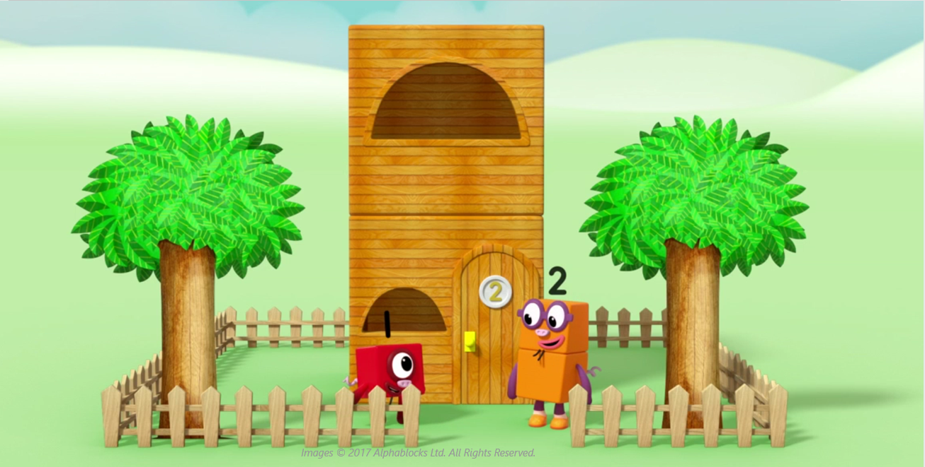
What can you see in the picture that there are 2 of?
Mastering Number 2021/22 ncetm.org.uk
Notes:
This activity asks children to look carefully at a picture and identify a quantity within it.
It is a lovely example of maths being embedded in observation and conversation. We can encourage children to notice groups, count to check and explain what they see.
At home, you can do the same with pictures in books, objects in a room, the dinner table or things you see outside.

Slide 18
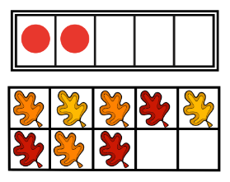
Five frames and Ten frames
Notes:
Five frames and ten frames are useful visual tools for developing number sense.
They help children see quantities in an organised way rather than as a collection of individual objects. This supports ideas such as 'one more', 'one less', numbers that make five and numbers that make ten.
When using a frame, give children time to talk about what they notice rather than turning it into a test. Don’t forget that there may possibly be some empty spaces or empty cells. Talking about what is there, but also what is not there, will help your child develop their understanding of composition of number. For example, knowing that there are 2 counters and 3 empty spaces but knowing that there are 5 spaces altogether will help your child to make sense of later mathematical equations such as 2+3=5 and 3+2=5 but also 5-2=3 and 5-3=2.

Slide 19
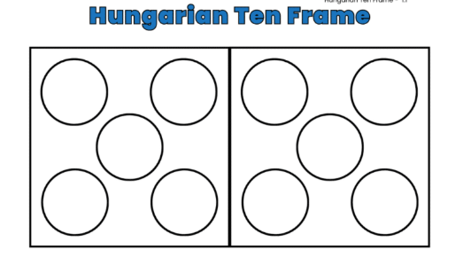
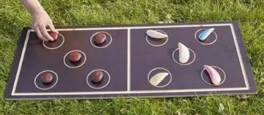
Hungarian Tens frame
Notes:
The Hungarian tens frame (or five frame when one half is used) is another way of representing number in an organised structure. This is often easier for children as it portrays a regular die pattern which they may be familiar with through playing games at home.
The purpose of these representations is to help children see the structure of numbers and the relationships between them. We are building understanding that will support children's later work with addition, subtraction, place value and calculation.
The most important thing for parents is to give children opportunities to see, talk about and play with quantities.

Slide 20
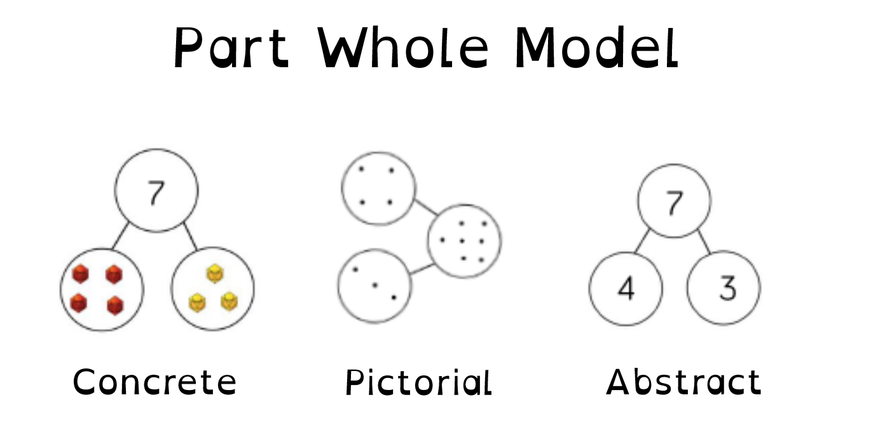
Notes:
Part-whole models
A part-whole model helps children understand that a number can be made up of smaller parts.
For example, 5 can be made from 3 and 2, or 4 and 1. The whole is 5, and the parts are the numbers that make it up.
Using objects, fingers, images and part-whole models helps children see these relationships, rather than simply memorising number facts. This develops a strong understanding of number and provides an important foundation for addition and subtraction.

